Slide 1
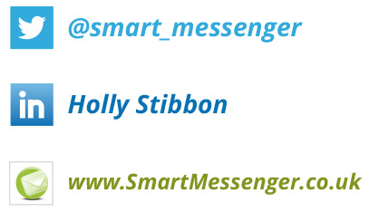

Slide 2
Email Marketing – The Essentials
Overview
The Law
Planning
Open & React
Evaluate Performance
Your Campaigns

Slide 3
The Law
Consent
Record keeping
Get up to date
Opt out
Compliant suppliers

Slide 4
Planning your Campaign
Setting objectives
Keep it simple
Part of your strategy
Audience
Follow up

Slide 5
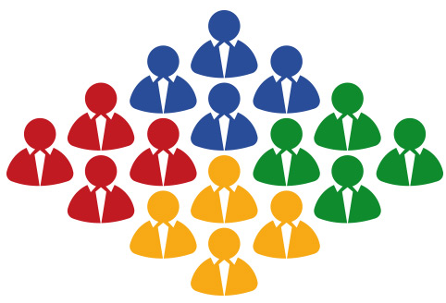
Target & Segment
Identify audiences
Demographic data
Behavioural data
Touch strategy
Refine & Improve

Slide 6
Is it just spam?
Deliverability
List Hygiene
Spam Check
Client Check

Slide 7
Get them to open
1
2
3
4

Slide 8
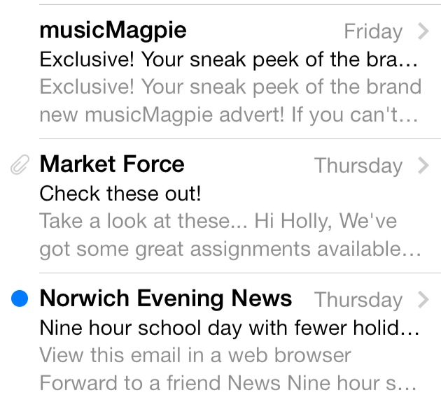
Get them to open
Friendly From
Subject Line
Pre Header
Preview
Timing
Find what works

Slide 9
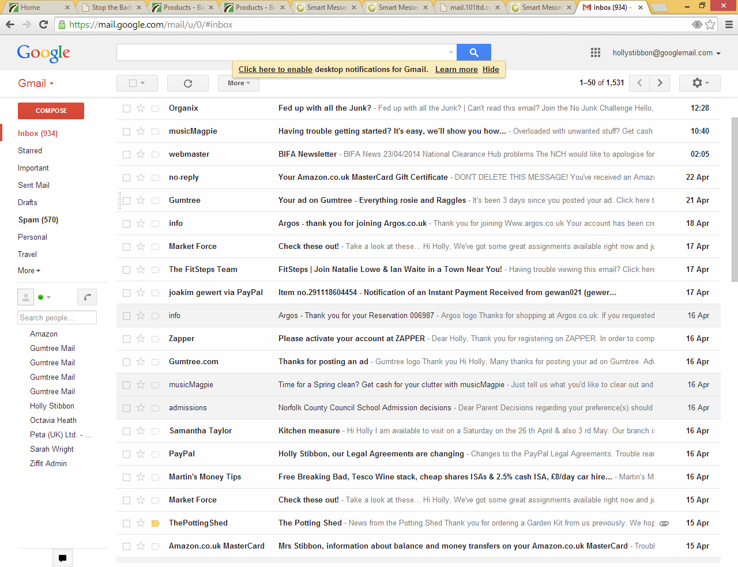

Slide 10
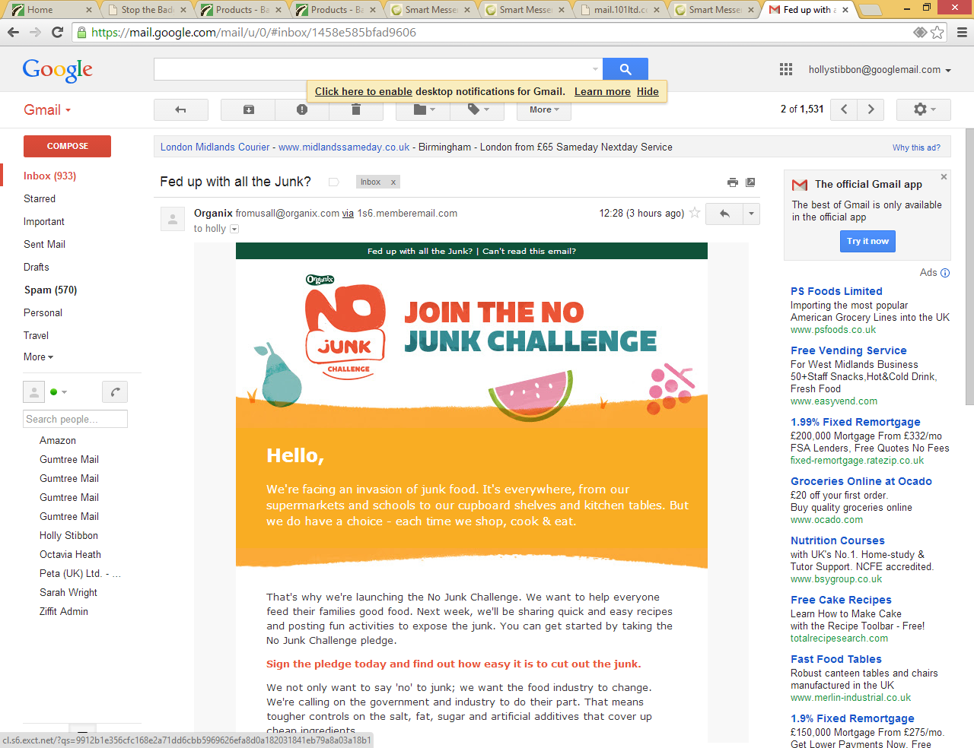

Slide 11
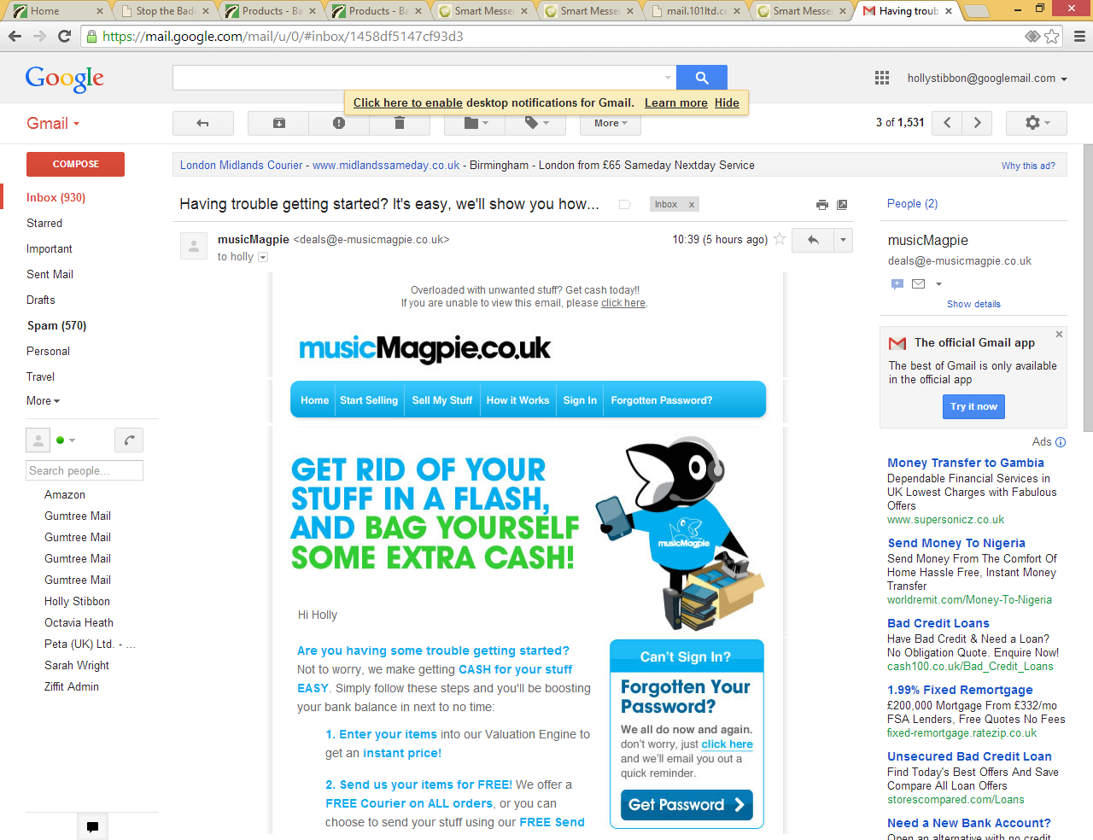

Slide 12
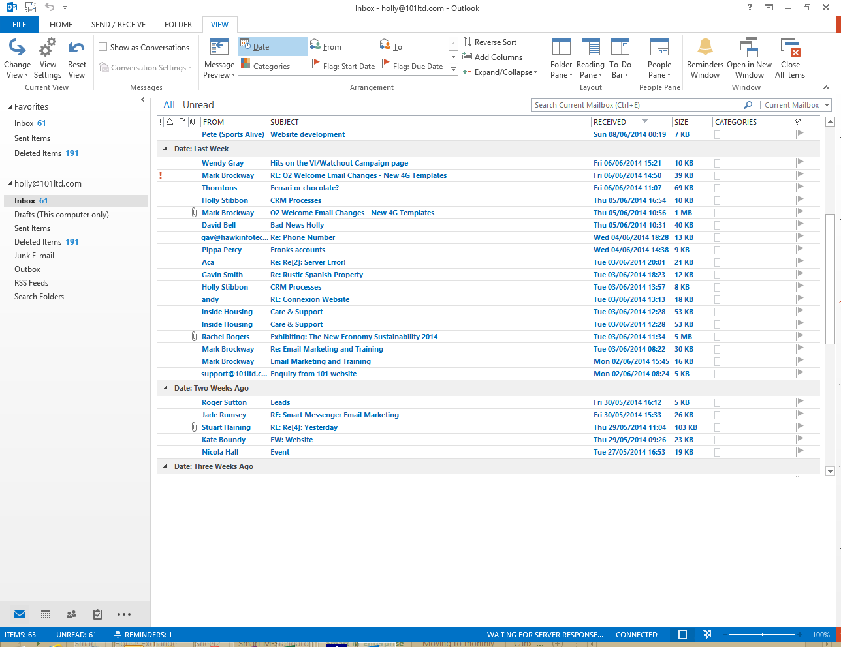

Slide 13
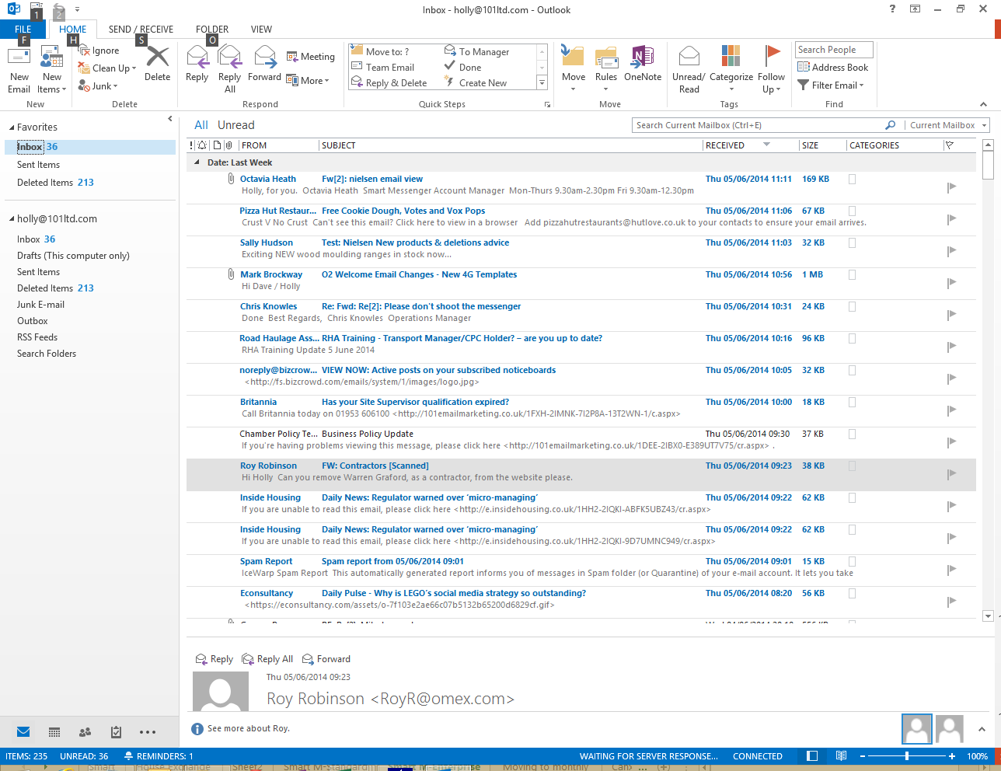

Slide 14
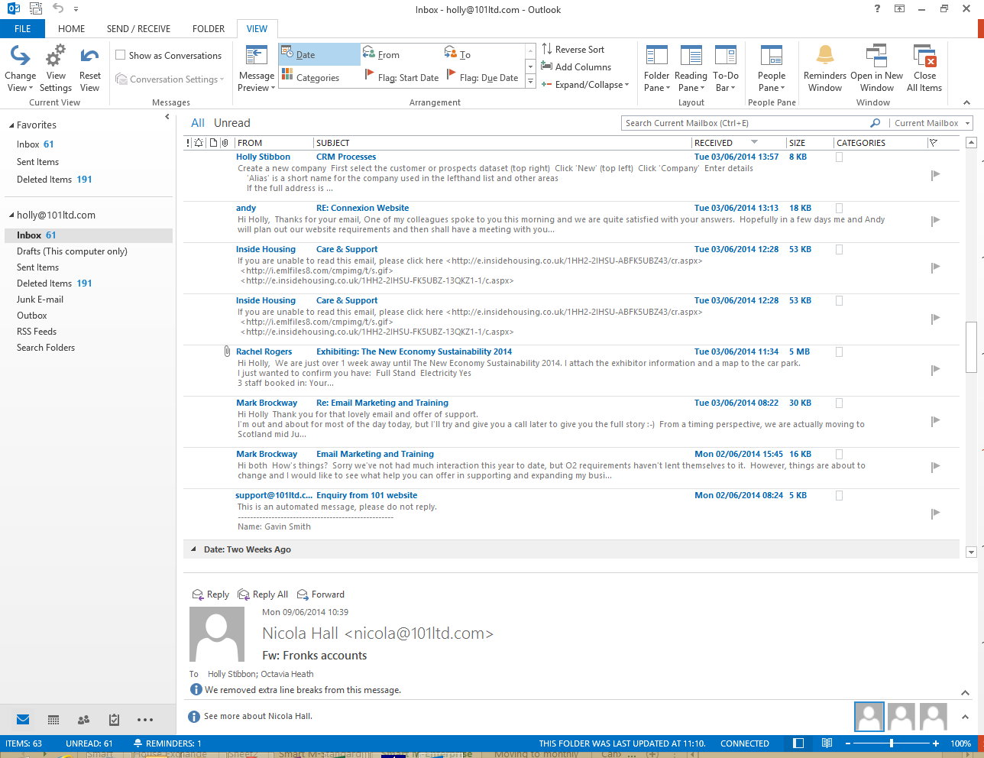

Slide 15
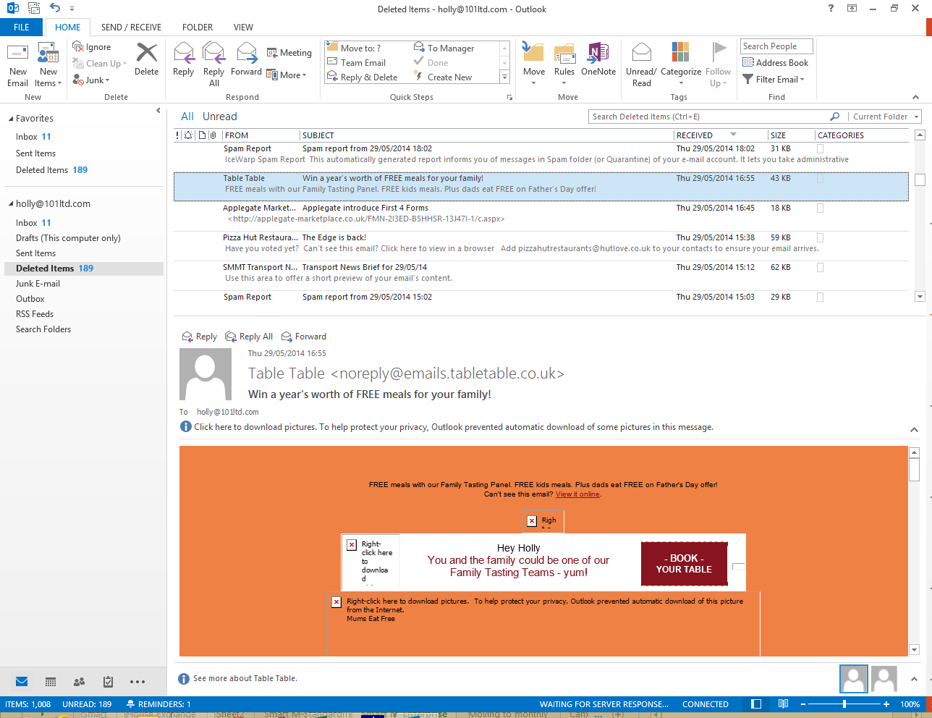

Slide 16
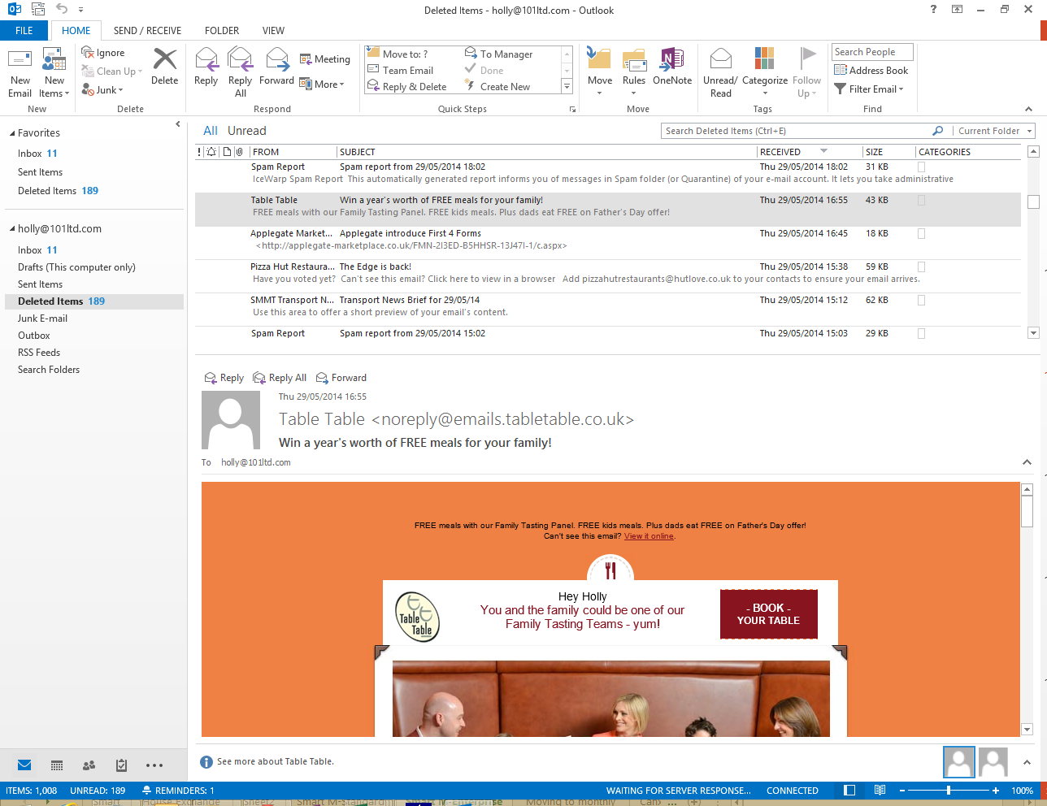

Slide 17
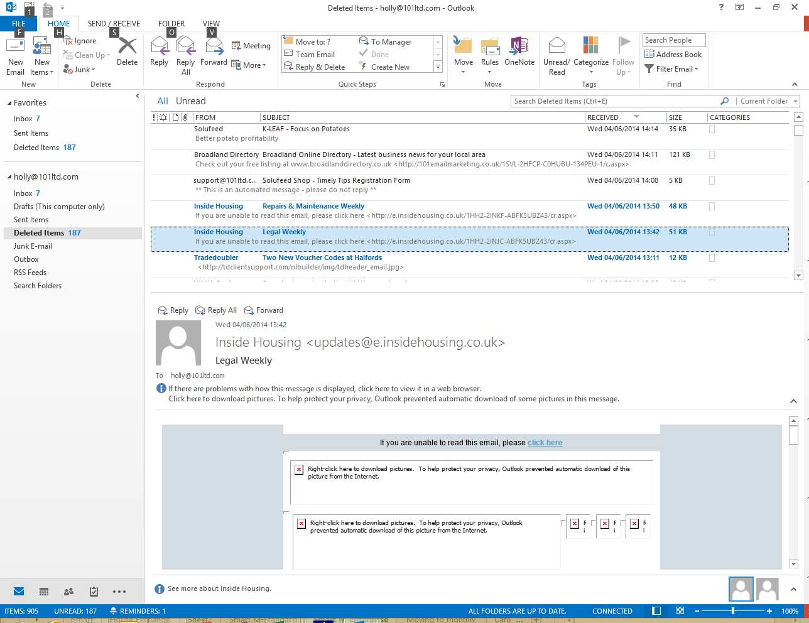

Slide 18
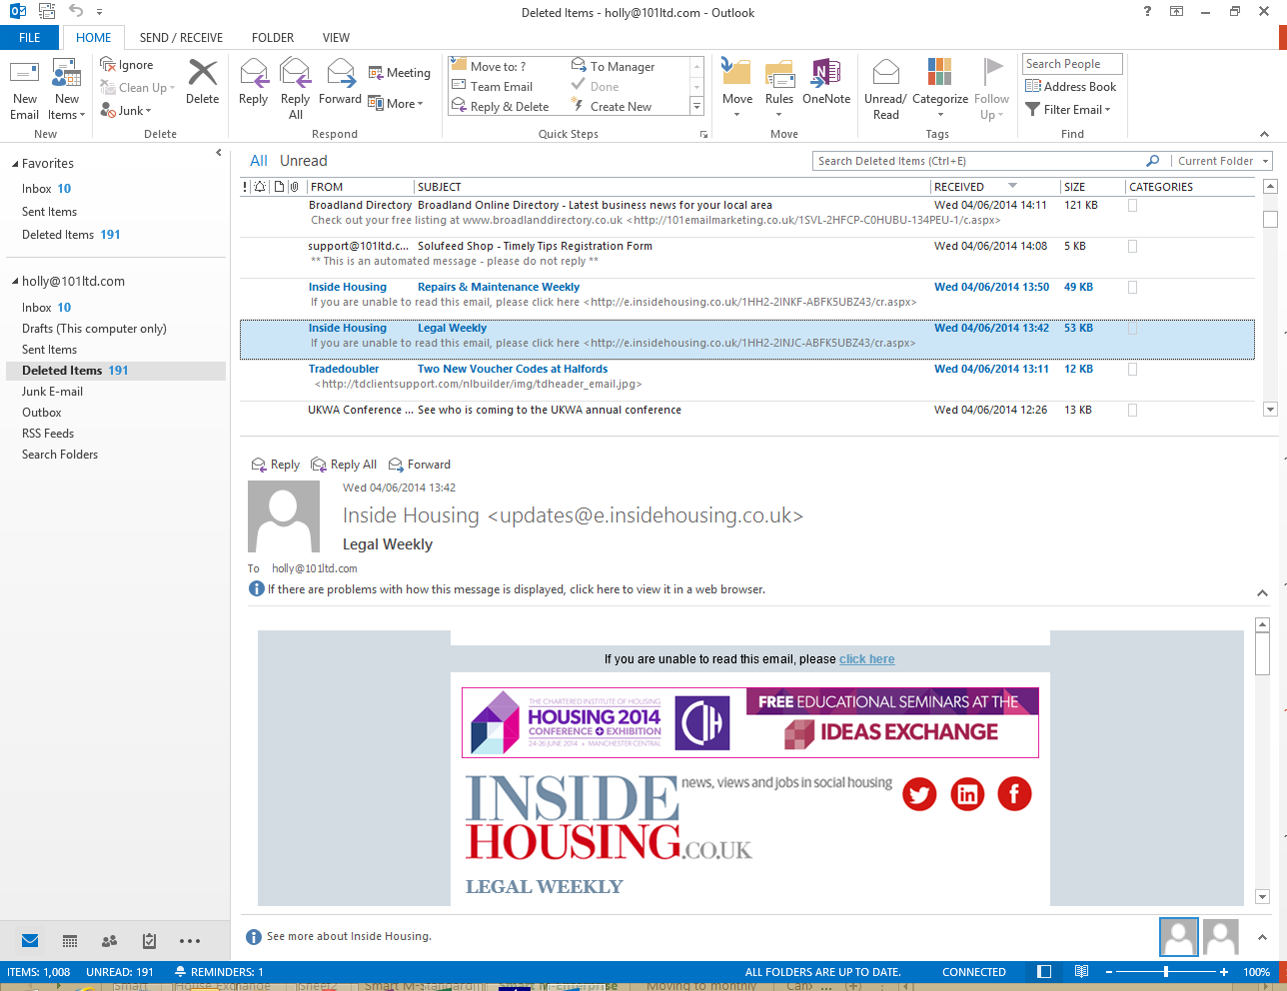

Slide 19
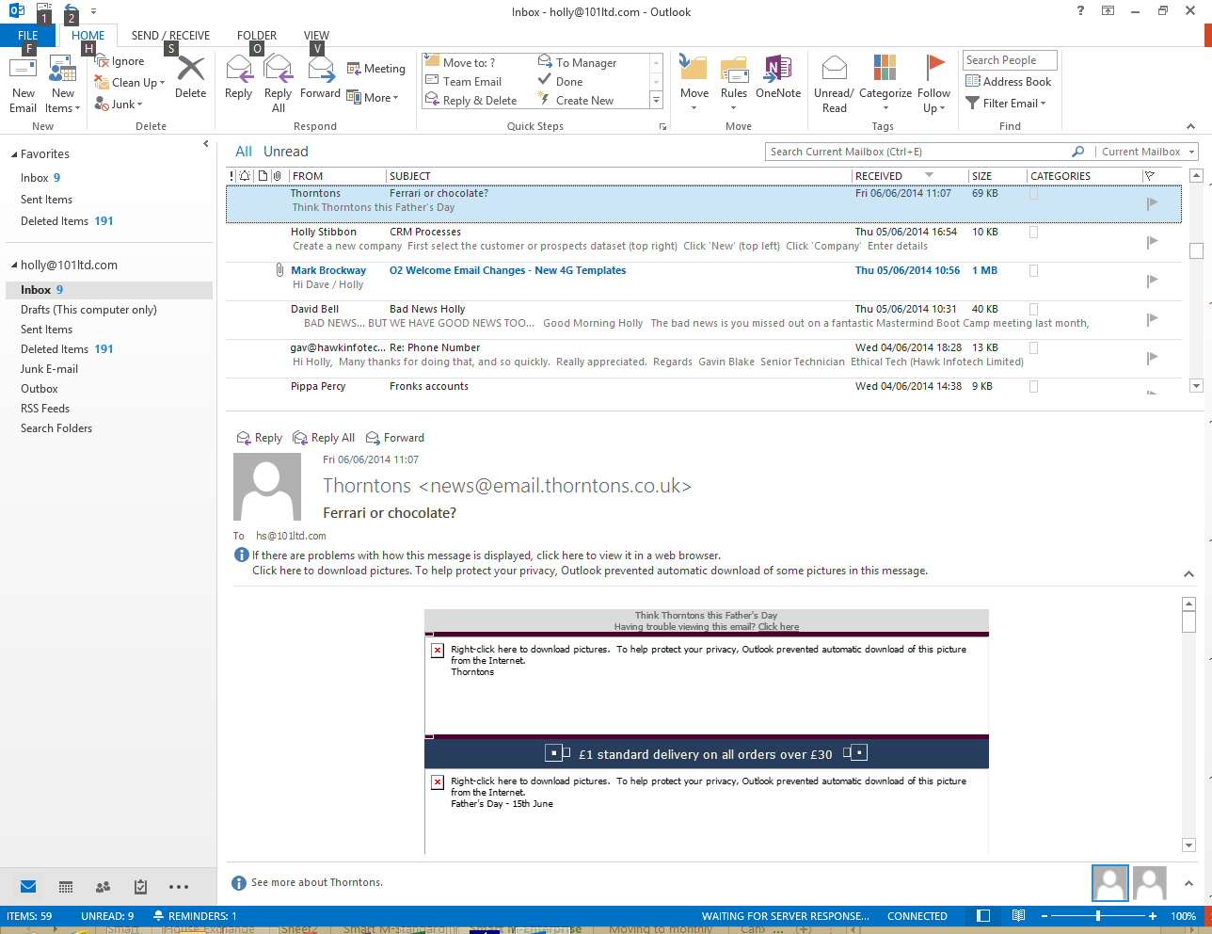

Slide 20
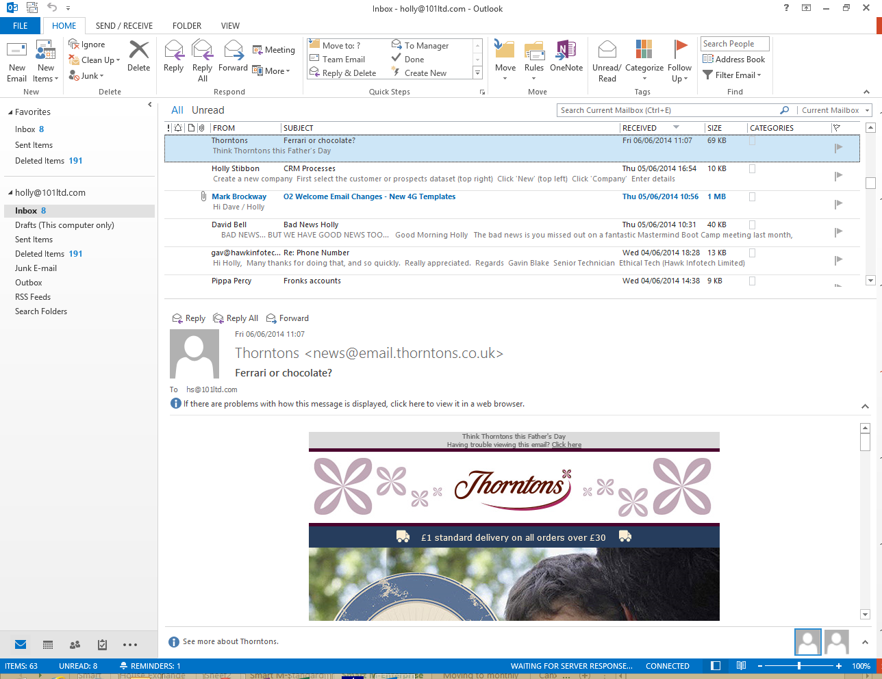

Slide 21
Get them to react
It’s an email
Personal
Relevant
Smart links
Call to action

Slide 22
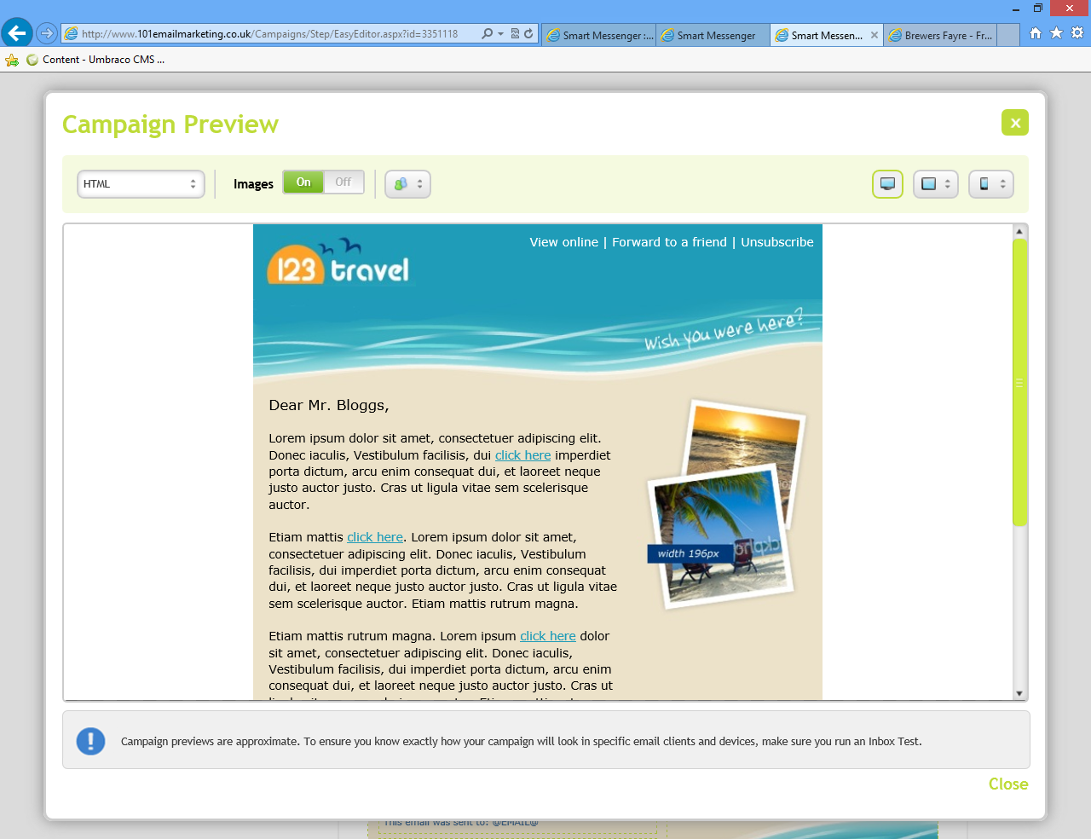

Slide 23
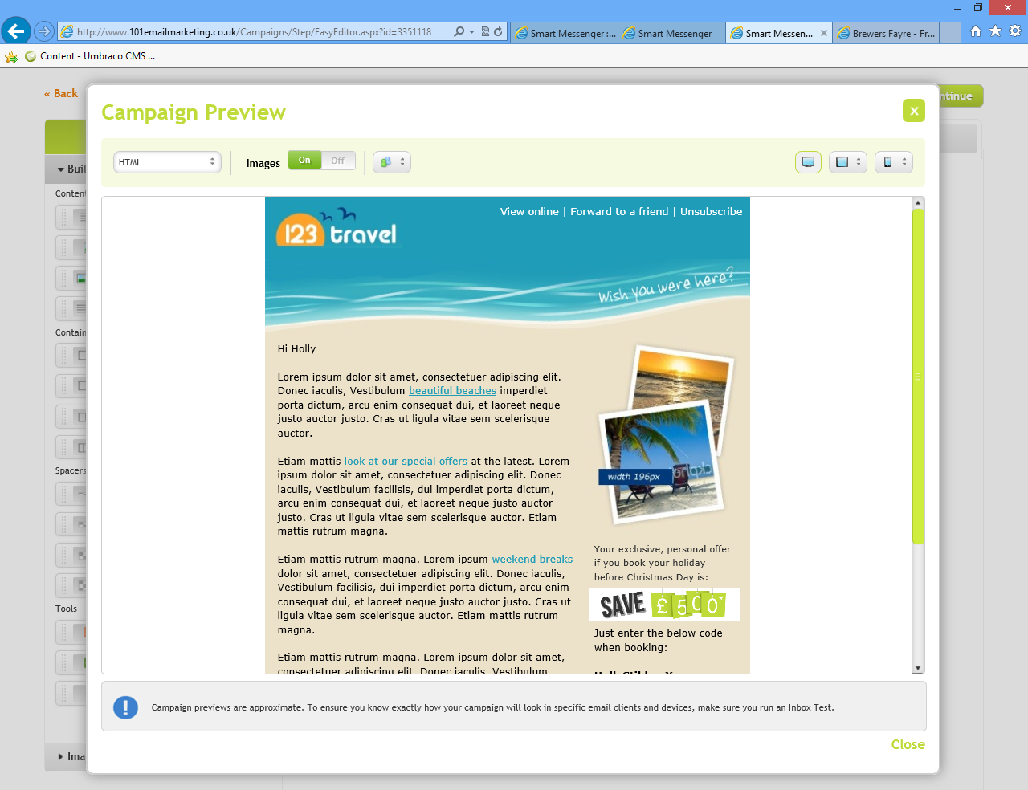

Slide 24
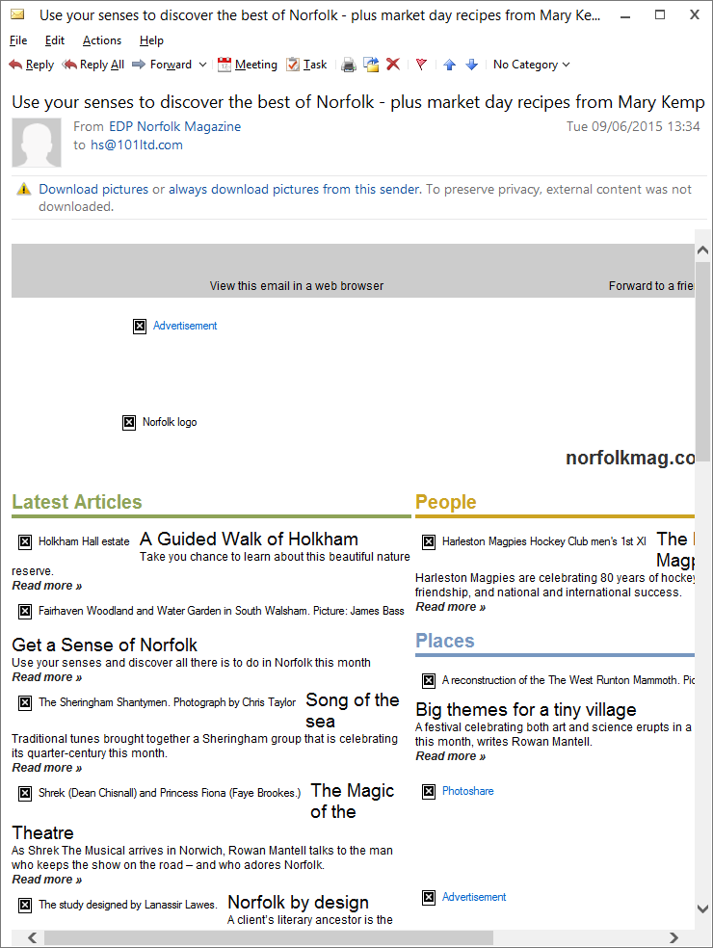

Slide 25
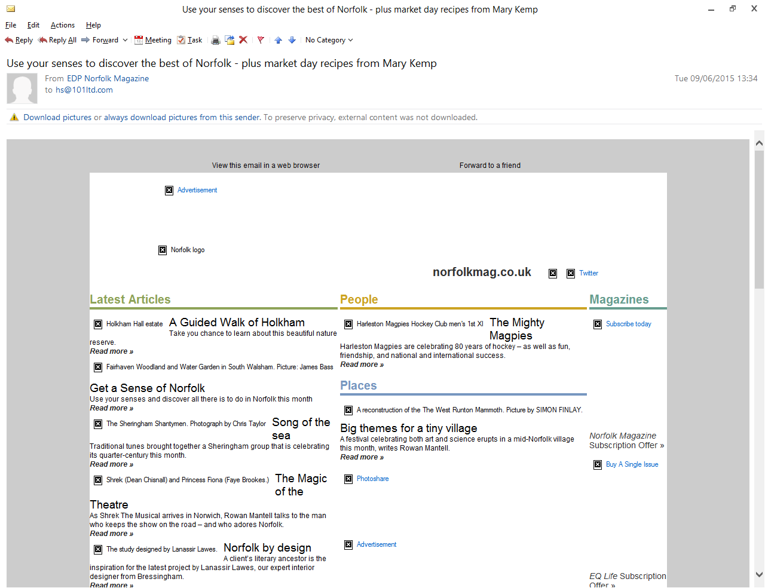

Slide 27
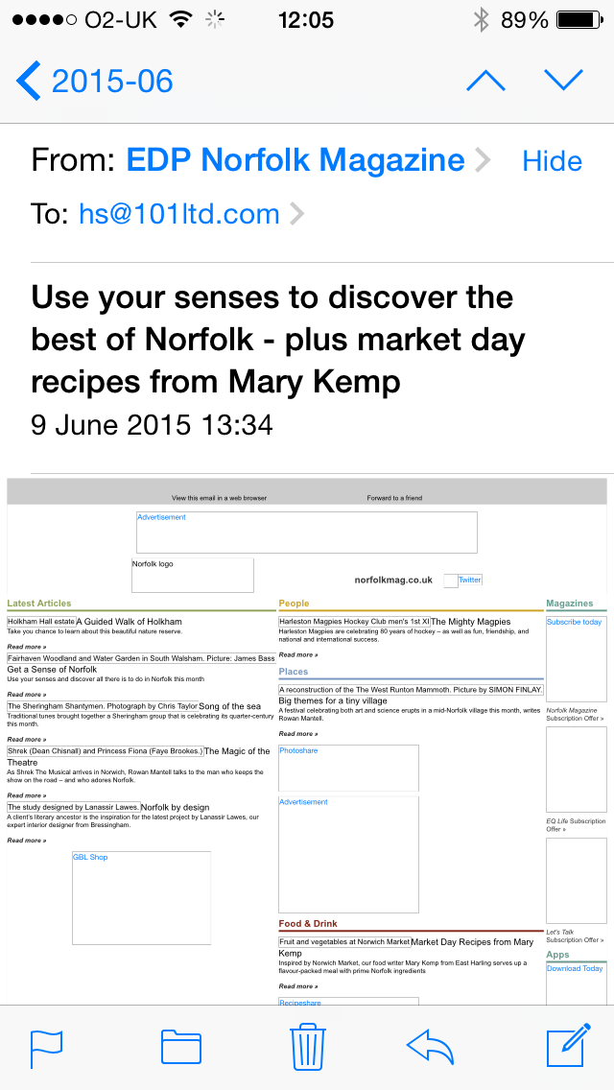

Slide 29
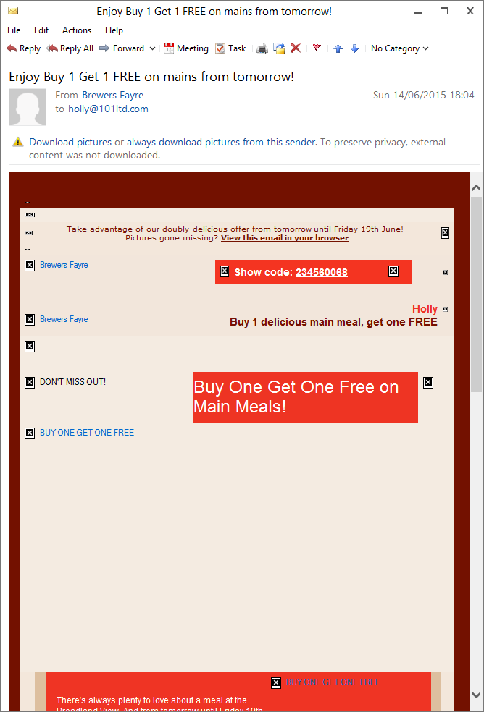

Slide 30
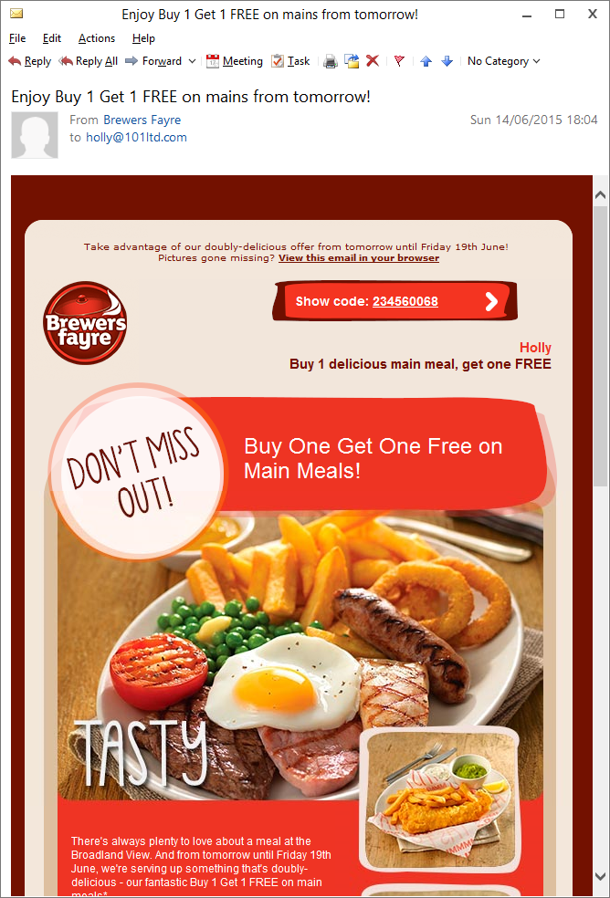

Slide 31
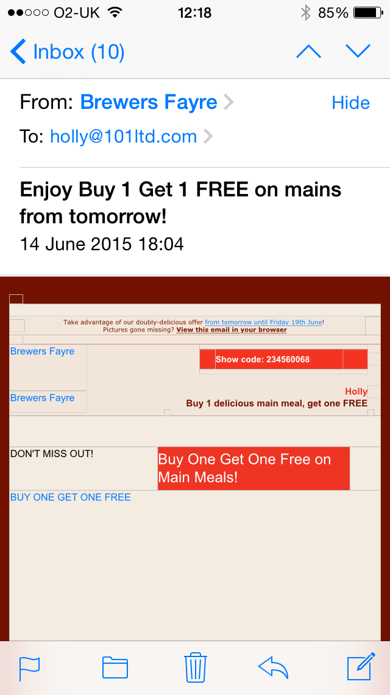

Slide 32
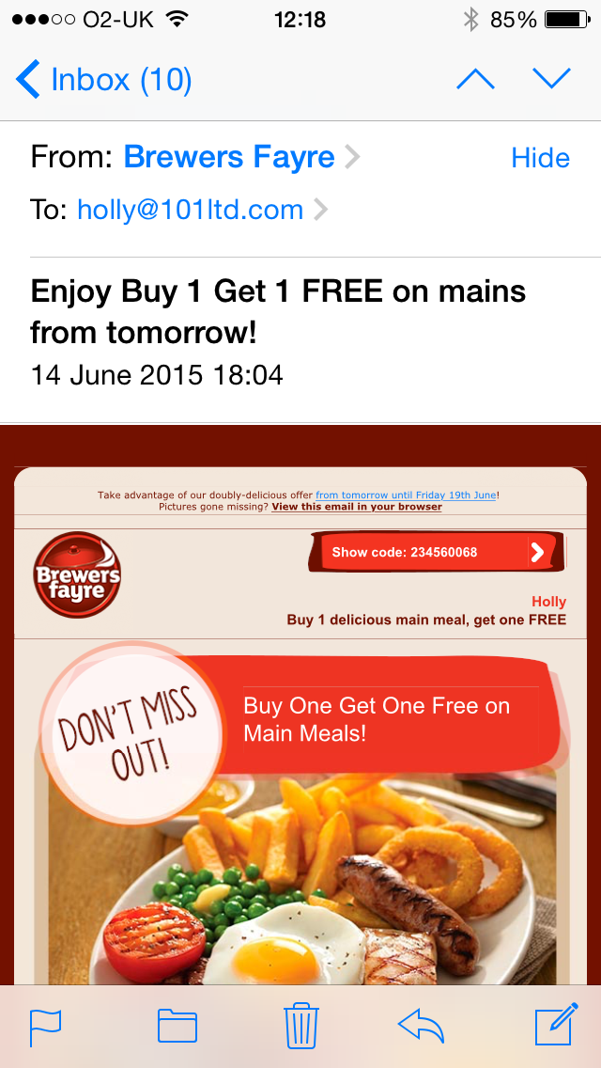

Slide 33
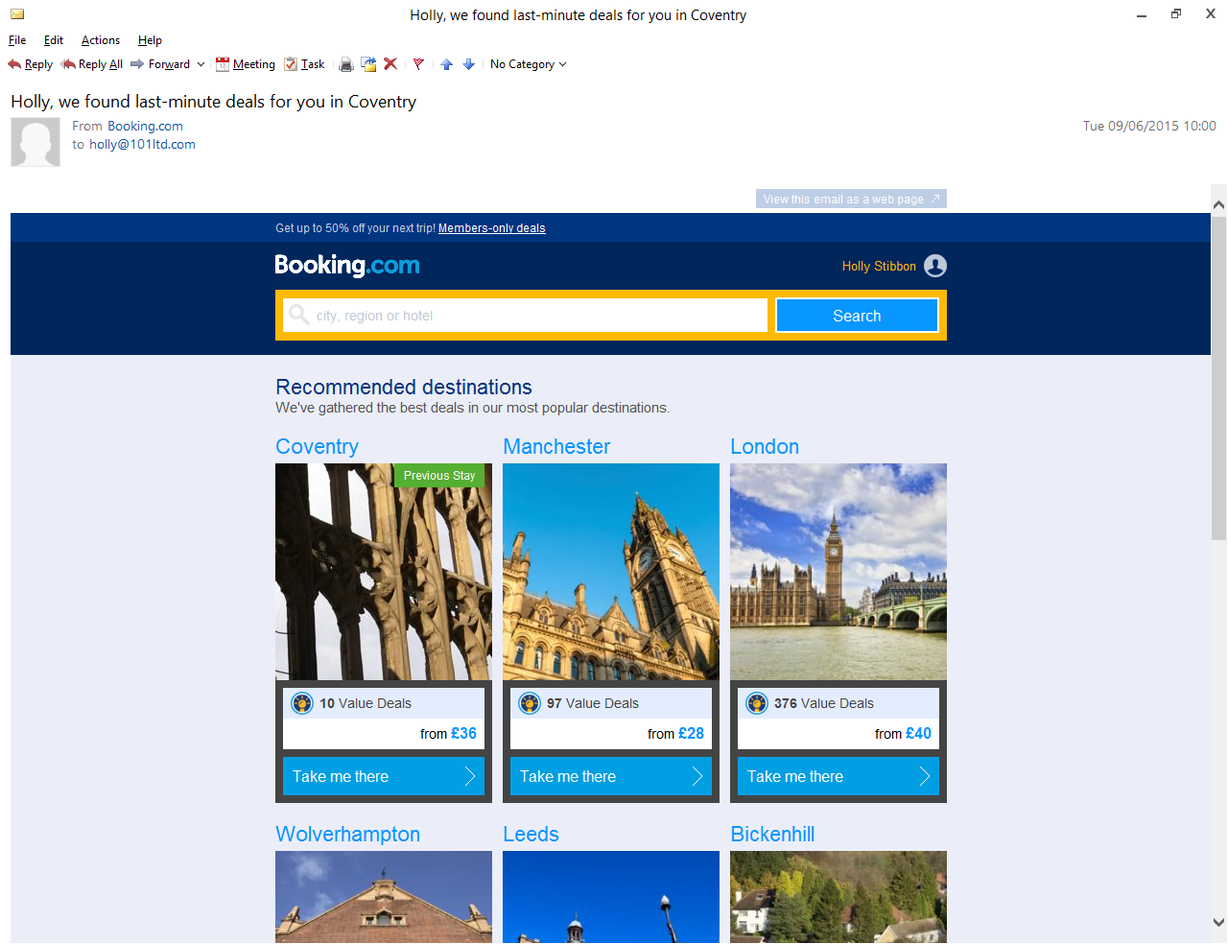

Slide 35
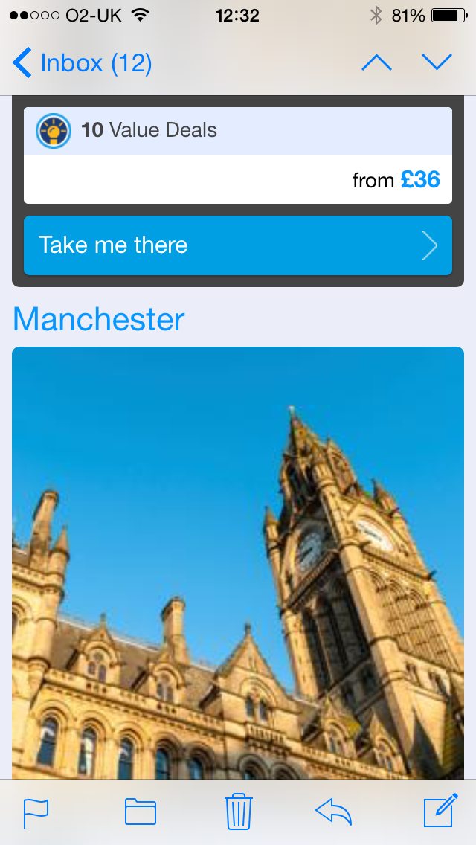

Slide 36
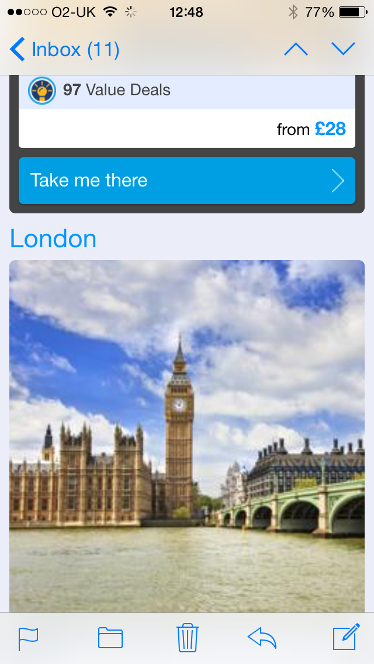

Slide 37
Track – Measure - Improve

Slide 38
Evaluate Performance
Opens
Clicks
Click to open
Replies
Views, traditional and social
Bounces & unsubscribes

Slide 39
Your Campaigns!

Slide 43
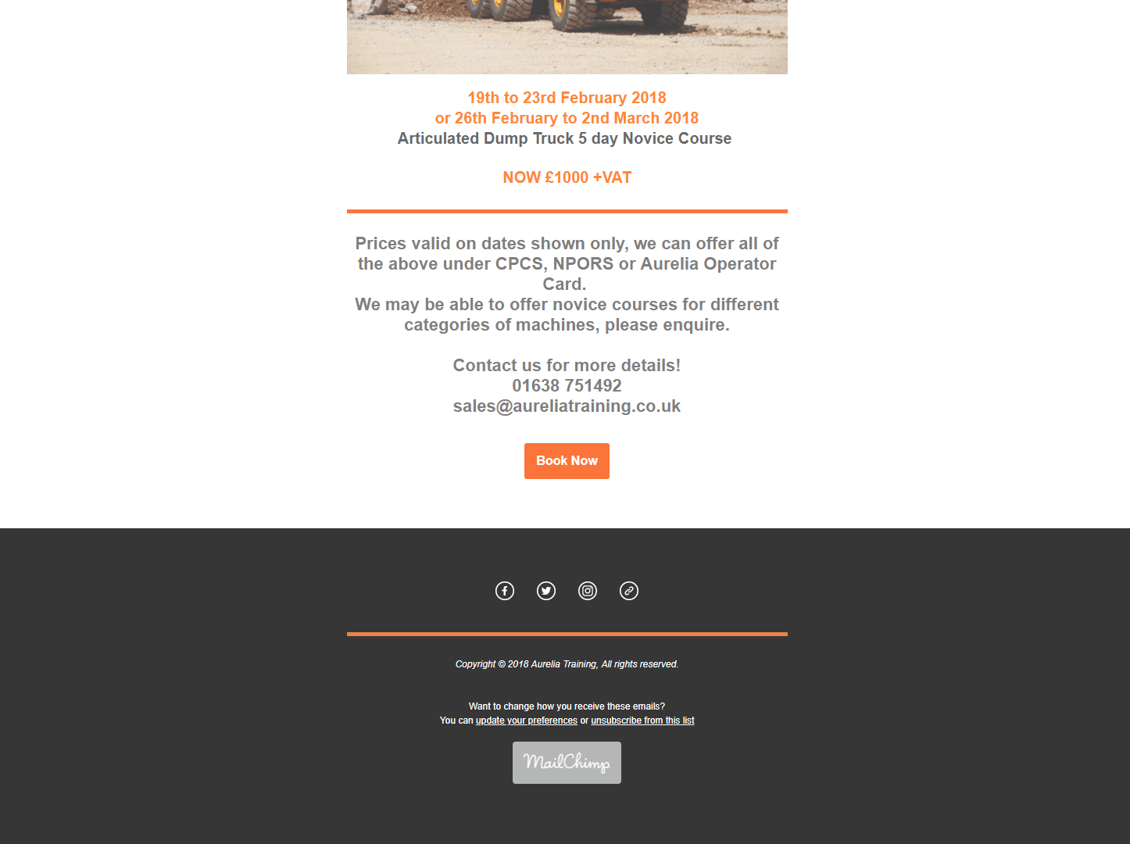

Slide 44
